Slide 1
Vulnerabilities in SPRESSO

Slide 2
Malicious FWD
goals
Steal user’s identity proof for honest RP (Confidentiality)
Identity injection for honest RP (Integrity)
Construct valid identity proof with malicious RP (Binding or Confidentiality)

Slide 3
Choose FWD
Malicious RP
always able to choose the malicious RP
choose the same honest FWD as honest RP
Honest RP
Choose honest FWD
Choose malicious FWD

Slide 4
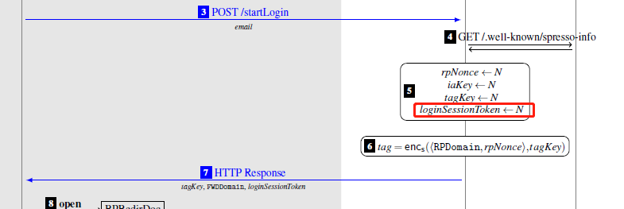
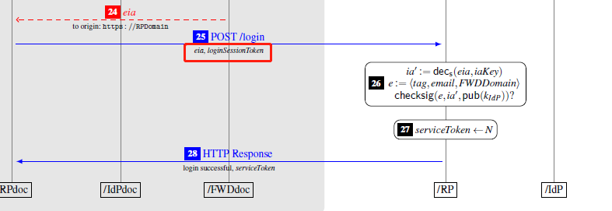
Steal user’s identity proof for honest RP
Don’t know user’s loginSessionToken
Invalid in other login flows

Slide 5
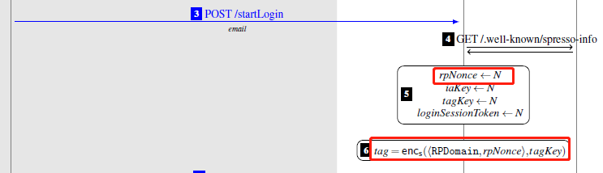
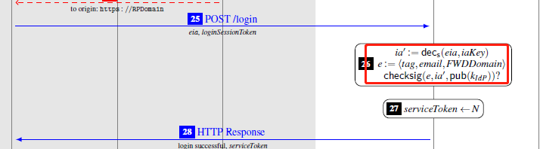
Steal user’s identity proof for honest RP

Slide 6
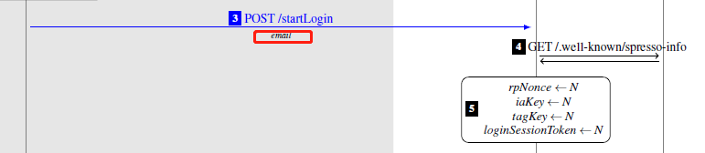
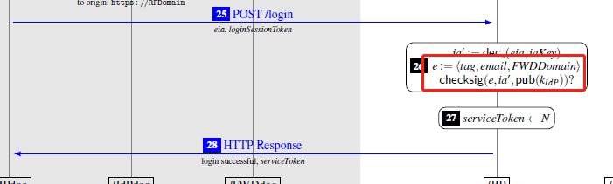
Identity injection for honest RP
Emails are inconsistent

Slide 7
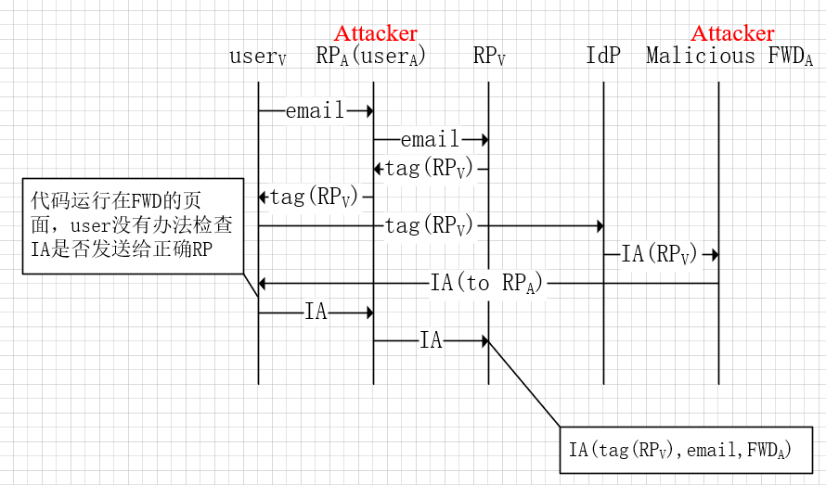
Construct valid identity proof with malicious RP
Honest RP chooses the malicious FWD

Slide 8
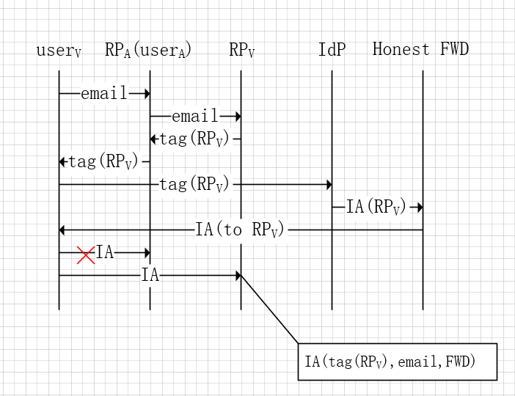
Construct valid identity proof with malicious RP
Malicious RP chooses the same honest FWD as honest RP

Slide 9
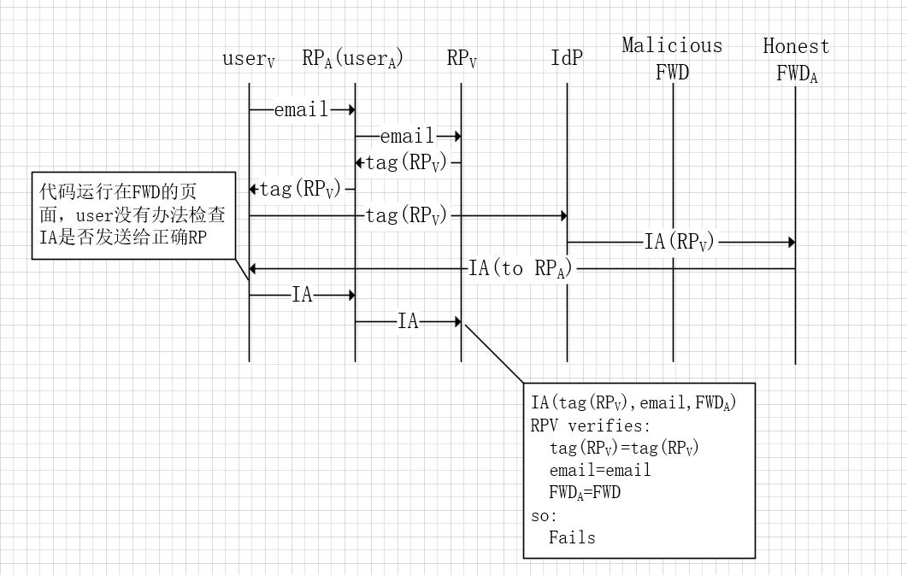
Construct valid identity proof with malicious RP
Honest RP chooses honest FWD, and malicious RP chooses malicious FWD

